Slide 1


SECURE SOFTWARE DEVELOPMENT (SSD)
Diploma in CSF
Academic Year (AY) 20/21 – Semester 3 (April `20)
Week 1
Module overview
Last Updated: 01/04/2020

Slide 2
Contents
Module Synopsis & Aims
Online Tool: Microsoft Teams
Teaching & Learning Approach: Experiential Learning
Development Tool: Visual Studio 2017 VM Image
Module Assessments
Remote Learning Instructions
Important Details & Ground Rules

Slide 3
Remote Learning Instructions
Step 1
Read Important Details & Ground Rules
Details in slide 4-5
Step 2
Read Module Synopsis & Aims of the Module
Details in slide 6-7
Step 3
Read Teaching & Learning Approaches
Details in slide 8-13
Step 4
Prepare online tool – MS Teams
Watch video and do activity - slide 14 -16
Do Mission 1.1 (Prepare development tool)
Do activities - slide 17-18
Step 5
Read up Module Teaching Team & Assessment – slides 19-20
Read up References – slide 21
Attempt Razor Pages learning – Slide 22

Slide 4
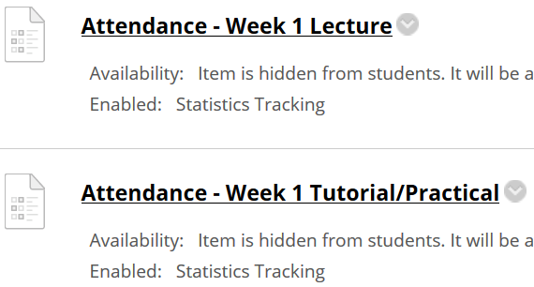
Important Details
VERY IMPORTANT
Visit MEL to start each week’s lesson. Learning materials will ONLY be released in MEL
Attendance Poll Attempt TWO attendance polls every week Starts Monday (9am) till Friday (11:59pm) Attendance :– Week x Lecture ( x refers to week number) Week x Tutorial/Practical Just click “Save and Submit”
Always lookout for announcements Do keep abreast of announcements in MEL
In light of the Covid-19 situation, your cooperation in adhering to the points mentioned is much needed and greatly appreciated.

Slide 5

Ground Rules
Though lessons are online till week 8, ground rules may be applicable when Face-to-Face (F2F) lesson resumes. Therefore, please note the ground rules for SSD.
Please be reminded that flouting the ground rules may result in deduction of points from Continual Assessment (CA) assessment.

Slide 6
Module Synopsis
Most of the current cyber attacks could be prevented by adopting secure software development practices.
This module provides students with the knowledge of
Secure software development lifecycle
Incorporating security throughout the entire process of software development
Designing, coding, testing and deploying software with a security mindset
This module trains students on
Identifying, gathering and recording security requirements for a software
Various security frameworks, considerations and methodologies
Software vulnerabilities and how to address their risks
Write secure code that is resilient against critical web application attacks
Secure software testing

Slide 7
Aims of the Module
To develop the understanding of secure software development lifecycle;
To develop the understanding of software vulnerabilities and their risks;
To develop the practical skills in secure software requirements gathering;
To develop the practical skills in secure software design;
To develop the practical skills in secure software coding;
To develop the practical skills in secure software testing and deployment.

Slide 8
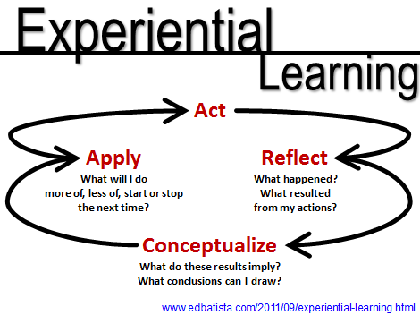
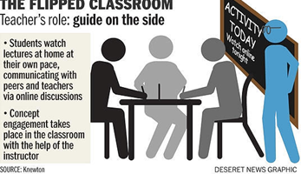


Teaching & Learning Approaches
Experiential Learning Slide 7 | Flipped Classroom Slide 8
No Spoon-feeding Slide 9 | Remote Learning Slide 10

Slide 9
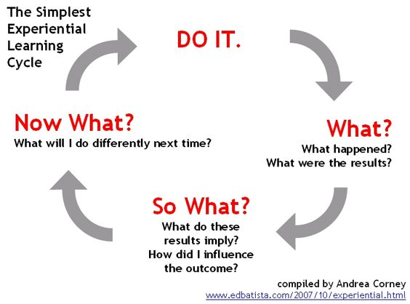
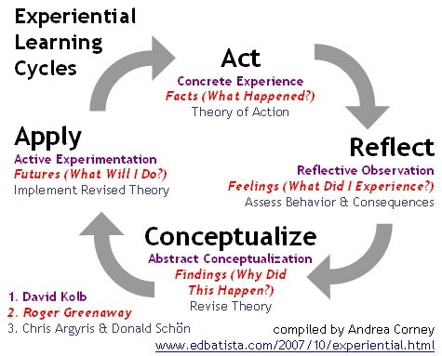
Teaching & Learning Approach: Experiential Learning
Experiential learning is inductive, learner -centered, and activity oriented.
Personalized reflection about the activity or experience and the formulation of plans to apply learning to other contexts are critical factors in effective experiential learning.

Slide 10
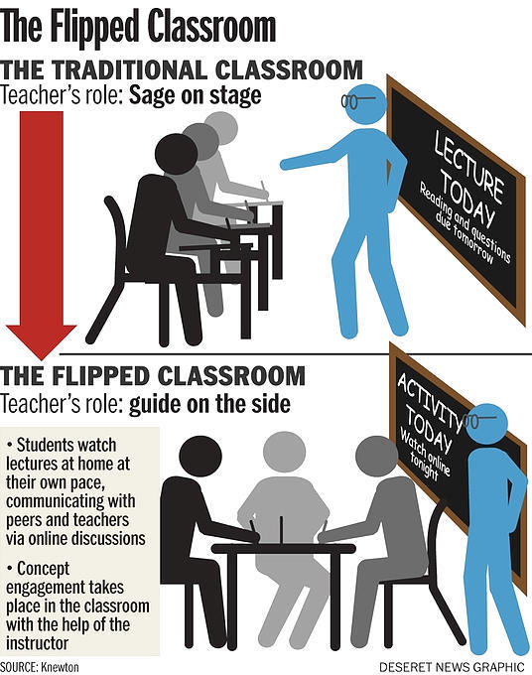
Teaching & Learning Approach: Flipped Classroom
Students learn content that are traditionally delivered in class, outside class, typically online and on a self-directed mode, prior to lesson time.
Sometimes the online learning include online discussions.
When students attend class, time would be devoted to more active learning activities, and deeper learning of the content learnt outside of the classroom.

Slide 11
Teaching & Learning Approach: No Spoon-feeding
Spoon feeding in the long run teaches us nothing but the shape of the spoon. - E. M. Forster
Spoon-feeding culture that inhibits critical thinking in students. https://smiletutor.sg/how-spoon-feeding-is-harmful-to-learning/

Slide 12
Teaching & Learning Approach: Remote Learning
In light of the Covid-19 situation, remote learning (online learning) will be part of SSD teaching and learning approaches. This means you will do self-directed learning. As such, you do not have to be physically present in campus for SSD class.
The SSD learning materials, would be made available in MEL. MEL will be the landing page to your other learning materials as well, if any.
Do be positive about remote learning as it will develop a life-long independent learners in you, who are able to manage their own time and learning.
Read Why Remote Learning?

Slide 13
Every lesson has 5 Components
There are 2 sessions each week for SSD.
Each session is 2 hours.
One session is for lecture/ tutorial.
The other session is for practical/assignment
Each lesson hopes to inculcate skills in learner whereby learner can thereafter, acquire knowledge.
Learner is also able to participate in mission (activity) to reflect (think) about the concepts taught.
Learner also has the opportunity to feedback on lessons delivered.
Skill
Knowledge
Thinking
Activity
Feedback
2 hr Lecture Lesson
2 hr Practical Lesson

Slide 14

Online Tool
Microsoft Teams
Experiential Learning
Flipped Classroom
Microsoft Teams
1. How to Download and Install Teams Desktop Client
https://www.youtube.com/watch?v=3BQ-M9z8nSM
2. Introduction to Microsoft Teams Series
https://www.youtube.com/watch?v=ssBG4mSjJJ8
https://www.youtube.com/watch?v=Q7Az0PAjif8
https://www.youtube.com/watch?v=2qtGOZQ0sGg

Slide 15
Activity: Microsoft Teams
Install Microsoft Teams as per video shown in slide 14
Please use your NP student account information to log in Teams
Ensure you can see the following Team groups upon successful installation and login:-
SSD-AY2021-xxx-Pxx
where xxx refers to your tutor name
Pxx refers to your class group in SSD
Form team of minimum 3 to a maximum 4 members.
Team Name:
Team Members: Name and NP email
( You can use Team’s conversation to communicate/coordinate team formation)

Slide 16
Activity: Microsoft Teams
The groups formed are meant as follow:
SSD-AY2021-xxx-Pxx
Discuss among group members
Write Wikis
Private channel - Team Name (Tutor will explain)
Discuss among team members
Write Wikis
Write individual reflections
Explanation

Slide 17
Activity: Development Tools
Download VirtualBox and SSD VM Image
VirtualBox 6.0 & above
Download and install from (www.virtualboxorg) - Refer to this website - https://www.youtube.com/watch?v=63_kPIQUPp8 Install the VirtualBox Extension Pack - Devices → Insert Guest Additions CD Image → Autorun
VM Image (Visual Studio 2017 + Tools) – SSD-AY1819-Wtools zipped files
https://tinyurl.com/y79vpgbq Total Size: 23GB Download zipped SSD VM image from link above. Extract the zipped SSD VM image into local notebook/laptop. SSD VM images contain Visual Studio IDE, BurpSuite, XAMMP and many others. *Students may opt to use Visual Studio IDE in own laptop/notebook. However, support is only given to Visual Studio in VM image.

Slide 18

Mission 1.1: Run SSD VM image in VirtualBox in laptop/notebook
Extract zipped SSD VM Image if you have not done so.
Double click on SSD-AY1819-WTools.vbox to open (add) the SSD VM into VirtualBox.
Refer to appended guide to troubleshoot issues on VirtualBox in notebook/laptop.
Screenshot the added SSD VM in VirtualBox and submit in MEL.
Password: sstudent
Use Teams conversation to discuss with friends or tutor, if assistance is needed.
Deadline: End of Week 1
Penalty for late submission

Slide 19
Teaching Team
Mr Francis Soh
Student group: P03
Email: Divyan_KONIDALA@np.edu.sg
Student group: P04
Email: Francis_Soh@np.edu.sg
Divyan M. Konidala (Dr)
Mr Mohd Saifulamri Omar (Module Leader)
Student groups: P01, P02
Email: Mohamed_Saifulamri_OMAR@np.edu.sg

Slide 20
Module Assessments
Assessment Type | Percentage
Continual Assessment (CA) | 30% Mission/Activity submissions (20%) Wikis, Reflections, Discussion Boards Participation (5%) NP’s R3ICG values (eg; helping team & class members, etc) (5%)
Test1 | Practical Test (10%) Quizzes (10%)
Group Assignment | 50%
Total Percentage | 100%

Slide 21
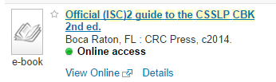
References
ASP.Net Tutorials
https://docs.microsoft.com/en-us/aspnet/core/tutorials/razor-pages/
Focusing on Razor Pages (MVVM)
Official (ISC)² Guide To The CSSLP CBK - Second Edition – by Mano Paul
CSSLP – Certified Secure Software Lifecycle Professional
CBK – Common Body of Knowledge
NP Library: https://bit.ly/2TM1Cxp →

Slide 22
Mission 3.3: Your First Razor Pages Application (Individual)
Please note that Razor Pages mission (Week 1-3) is intentionally released early. The intent is to help you pace learning on Razor Pages.
Visit https://docs.microsoft.com/en-us/aspnet/core/tutorials/razor-pages/
Attempt the following topics:-
Create a Razor Pages web app
Add a model to a Razor Pages app in ASP.NET Core
Scaffolded Razor Pages in ASP.NET Core
Work with a database and ASP.NET Core
Update the generated pages in an ASP.NET Core app
Collate detailed screenshots of each of the completed topic in a word document.
The screenshots must show the browser’s “Address Bar” to verify the application is running in your laptop.
Note: Refer to document below for changing to NetCore 2.2 if you are using your own visual studio.

Slide 23
Mission 3.3: Your First Razor Pages Application (Individual) – Con’t
Please note that Razor Pages mission (Week 1-3) is intentionally released early. The intent is to help you pace learning on Razor Pages.
Visit https://docs.microsoft.com/en-us/aspnet/core/tutorials/razor-pages/
Attempt the following topics:-
Create a Razor Pages web app
Add a model to a Razor Pages app in ASP.NET Core
Scaffolded Razor Pages in ASP.NET Core
Work with a database and ASP.NET Core
Update the generated pages in an ASP.NET Core app
Guided Videos (Visual Studio 2017)
https://www.youtube.com/watch?v=F0SP7Ry4flQ
https://www.youtube.com/watch?v=sFVIsdR_RcM
https://www.youtube.com/watch?v=zxgKjPYnOMM
https://www.youtube.com/watch?v=A_5ff11sDHY
https://www.youtube.com/watch?v=yLnnleREMtQ
For Visual Studio 2019, refer to attached guide to create/start project in Visual Studio 2019. Once project created in 2019, you can follow steps as per guided worksheet.

Slide 24
Summary
This module provides students with the knowledge of Secure software development lifecycle.
Incorporating security throughout the entire process of software development.
Teaching & Learning Approach
Experiential learning
Flipped Classroom
Module Assessments
CA: 30%
Test 1: 20%
Group Assignment: 50%
MEL / Microsoft Teams

